Slide 1
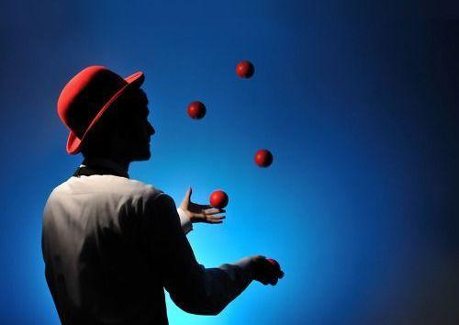
My Hobby

Slide 2
Pros and Contras
Its good because:
Improve concentration
You always can be better with trying different objects
Fun at parties :)
...but the bad side is:
It can be dangerous
Need so much practice
You can’t get tired in this

Slide 3
Juggling
Juggling is a physical skill, performed by a juggler, involving the manipulation of objects for recreation, entertainment, art or sport. The most recognizable form of juggling is toss juggling. Juggling can be the manipulation of one object or many objects at the same time, most often using one or two hands but also possible with feet. Jugglers often refer to the objects they juggle as props.

